Slide 1

CSC6302 - Database Principles
Week 1 - Wendy-Beth Minton

Slide 2

Course Introduction
This course is entitled CSC6302 Database Principles
In this course we will:
Design relational database
  Functional dependencies
  Normal Forms
  Normalizing Databases
Learn the relational database language SQL
Develop database applications using Java/Python
Understand how data is stored within a relational database
Leverage our knowledge of relational databases and their storage mechanisms to optimize how we write queries
CSC 6302 - Week 1

Slide 3

Course Format
Weeks 1-8 of this course will have:
Live Sessions
  Every Tuesday from 6:30pm to 8:30pm
Live Office Hours
  Thursday 8:00pm to 9:00pm
  By appointment
Weeks 1-7 will have graded:
Practice
Online Quizzes
Programing assignments
Week 8 will have
Graded final exam
Communication:
mintonw@merrimack.edu

Slide 4
Course Format
Practice
  Simple exercises
  Design exercises
  Will be tied to the programming assignment
  Submitted via Canvas
Quizzes
  10-15 questions
  Autograded, and then adjusted up as needed
    Multiple selection questions are auto graded poorly in Canvas
  Open book, open notes
  Submitted via Canvas
Final exam
  Questions from all eight units
  4 hours to complete after starting
  Open book, open notes
  Submitted via Canvas
Attendance is optional, but strongly recommended!
Your WebCam is optional, but strongly recommended!

Slide 5
Course Format
Practice and Programming Projects
  All assignments may be done in Python or Java
    Whichever you are comfortable with
    README file for programming assignments is needed
      Exact version of Python/Java you are using
      Exact version of the OS you are using
      Exact version of MySql you are using
  All programming assignments must have a git repository
    I must be added as a collaborator
    A link to your repository must be submitted to canvas
      Easier for me to find each person’s repository
      Easier for you to see your grade on each assignment
  Do not upload your code to Canvas
I’m easy to find as a collaborator on github
  mintonw@merrimack.edu
Attendance is optional, but strongly recommended!
Your WebCam is optional, but strongly recommended!

Slide 6
Evaluation
All task due dates are listed in Canvas.
  Practice are Due Saturday night by 11:59 pm
  Quiz is due Monday by 11:59 pm
  Programming Assignments are due by Monday at 11:59 pm
Late assignments receive a 5% penalty for each full day of delay.
  If the deadlines are a struggle, given your personal circumstances, please reach out to me, and we can make adjustments as needed
Group | Weight
Practice | 10%
Projects | 60%
Quizzes | 10%
Final Exam | 20%
Total | 100%
Final deadline on Sunday of the course's last week

Slide 7
Evaluation
The final letter grade is computed according to this table:
A | A- | B+ | B | B- | C+ | C | C- | F
95 and up | 90 to 94.9 | 87 to 89.9 | 83 to 86.9 | 80 to 82.9 | 77 to 79.9 | 73 to 76.9 | 70 to 72.9 | 69.9 and low
There are no grade D+, D, or D- in graduate courses.
An average grade B is required to the Masters of Science in Computer Science.
Final grades published after the course's end.

Slide 8
Using AI, YES! However...
Documentation & Disclosure Requirements To maintain academic integrity, any use of Generative AI must be transparently documented. This is akin to citing your sources. The expectation of this course is that Generative AI use if limited to the following tasks:
Explaining course concepts or errors
Tutoring
Understanding syntactic query elements
Understanding python/java code elements
Generating test data
Ownership and Accountability While you may use AI to assist you, you must own your code. This entails the following:
Technical Understanding: You must be able to explain, defend, and modify every line of code submitted.
Functional Grading: If the submitted code does not run, it cannot be graded, regardless of whether AI was used to generate it.
Human-Centric Design: Remember that documentation is for humans to understand the logic of the code; AI-generated documentation must still meet human standards for readability and specification.

Slide 9

Agenda
Discussion Topics:
Databases and Database Applications
The Relational Model
Entity Relational Diagrams (ER Diagrams)
  Database Table Design
Database Systems
  Database Architecture
  Database Engine
SQL - The Basics
  Create Table
  Insert
  Update
  Integrity Constraints

Slide 10
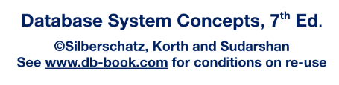
Recommended Reading
Chapter One: Introduction
Chapter Two: Introduction to the Relational Model
  2.1-2.5
Chapter Six: Database Design Using the E-R Model
  6.1-6.6
  Note this chapter goes deeper into the E-R Model then necessary for this course
  Please see the additional resources for the class on making E-R Models in MySQL Workbench
Chapter Three: Introduction to SQL
  3.1-3.2
3.9
Slides adapted for CSC6202: Database Principles from:

Slide 11
Database Systems
A database is a collection of interrelated data.
A database system is a collection of interrelated data, and the programs needed to access that data.
"The entire information content of the database is represented in one and only one way—namely, as explicit values in column positions in rows in tables."
— C.J. Date, An Introduction to Database Systems
CSC 6302 - Week 1

Slide 12
Database Management System
DBMS contains information about a particular enterprise
  Collection of interrelated data
  Set of programs to access the data
  An environment that is both convenient and efficient to use
Database systems are used to manage collections of data that are:
  Highly valuable
  Relatively large
  Accessed by multiple users and applications, often at the same time.
A modern database system is a complex software system whose task is to manage a large, complex collection of data.
Databases touch all aspects of our lives

Slide 13
Database Application Examples
Enterprise Information
  Sales: customers, products, purchases
  Accounting: payments, receipts, assets
  Human Resources: Information about employees, salaries, payroll taxes.
Manufacturing: management of production, inventory, orders, supply chain.
Banking and finance
  customer information, accounts, loans, and banking transactions.
  Credit card transactions
  Finance: sales and purchases of financial instruments (e.g., stocks and bonds; storing real-time market data
Universities: registration, grades

Slide 14
Database Application Examples
Airlines: reservations, schedules
Telecommunication: records of calls, texts, and data usage, generating monthly bills, maintaining balances on prepaid calling cards
Web-based services
  Online retailers: order tracking, customized recommendations
  Online advertisements
Document databases
Navigation systems: For maintaining the locations of various places of interest along with the exact routes of roads, train systems, buses, etc.
Medical Record Systems
Social Media Sites
Video Games (or any application) with customization options

Slide 15
Purpose of Database Systems
In the early days, database applications were built directly on top of file systems, which leads to:
Data redundancy and inconsistency: data is stored in multiple file formats resulting in duplication of information in different files
Difficulty in accessing data
  Need to write a new program to carry out each new task
Data isolation
  Multiple files and formats
Integrity problems
  Integrity constraints (e.g., account balance > 0) become “buried” in program code rather than being stated explicitly
  Hard to add new constraints or change existing ones

Slide 16
Purpose of Database Systems
Atomicity of updates
  Failures may leave database in an inconsistent state with partial updates carried out
  Example: Transfer of funds from one account to another should either complete or not happen at all
Concurrent access by multiple users
  Concurrent access needed for performance
  Uncontrolled concurrent accesses can lead to inconsistencies
    Ex: Two people reading a balance (say 100) and updating it by withdrawing money (say 50 each) at the same time
Security problems
  Hard to provide user access to some, but not all, data
Database systems offer solutions to all the above problems

Slide 17
View of Data
A database system is a collection of interrelated data and a set of programs that allow users to access and modify these data.
A major purpose of a database system is to provide users with an abstract view of the data.
  Data models
    A collection of conceptual tools for describing data, data relationships, data semantics, and consistency constraints.
  Data abstraction
    Hide the complexity of data structures to represent data in the database from users through several levels of data abstraction.

Slide 18
The Relational Model
Ok, so now we know what a database is, conceptually, and what a database system is.
Likely, we have used several database systems this week!
But, how do we go about describe and defining database management system?
"Information is data that has been given meaning by way of relational connection."
— Russell L. Ackoff, From Data to Wisdom (1989)
CSC 6302 - Week 1

Slide 19
Data Models
A collection of tools for describing
  Data
  Data relationships
  Data semantics
  Data constraints
Entity-Relationship data model (mainly for database design)

Slide 20
University Database Example
In this course, we will be looking at a University database example, something we are all familiar with
Data consists of information about:
  Students
  Instructors
  Classes
Application program examples:
  Add new students, instructors, and courses
  Register students for courses
  Generate class rosters
  Assign grades to students
  Compute GPA and generate transcripts

Slide 21
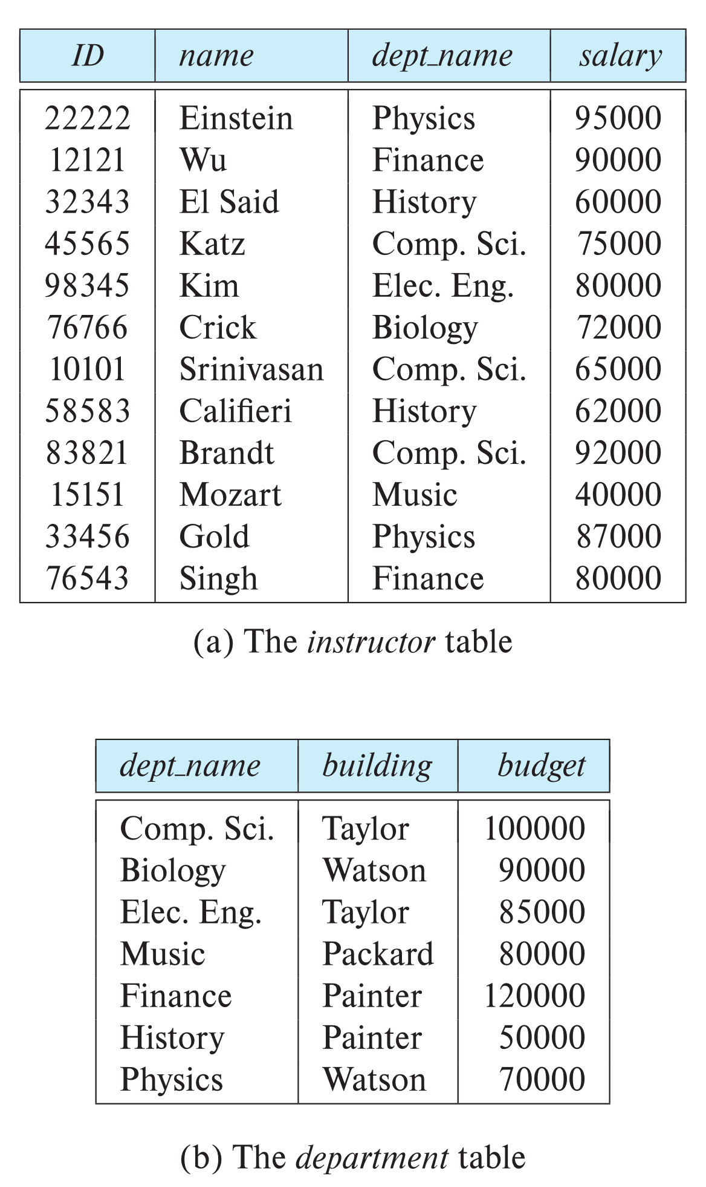

Relational Model
All the data is stored in various tables.
Example of tabular data in the relational model
Columns
Rows
Ted Codd
Turing Award 1981
Tedd Codd

Slide 22
A Simple Relational Database

Slide 23
Relation Schema and Instance
The columns are attributes
  Domain
    The set of allowed values for each attribute
  Attribute values are (normally) required to be atomic
    indivisible
ACID
  Atomic
  Consistency
    The database is always in a consistent state
  Isolation
    Transactions don’t interfere with each other
  Durability
    Once you make changes, they are permanent
ACID

Slide 24
Relation Schema and Instance
Relation schema
  A Table name, and its attributes
  Example
instructor = (ID, name, dept_name, salary)
Table Instance
  The current values a relation
Tuple
  An element t of relation r
  Represented by a row in a table

Slide 25
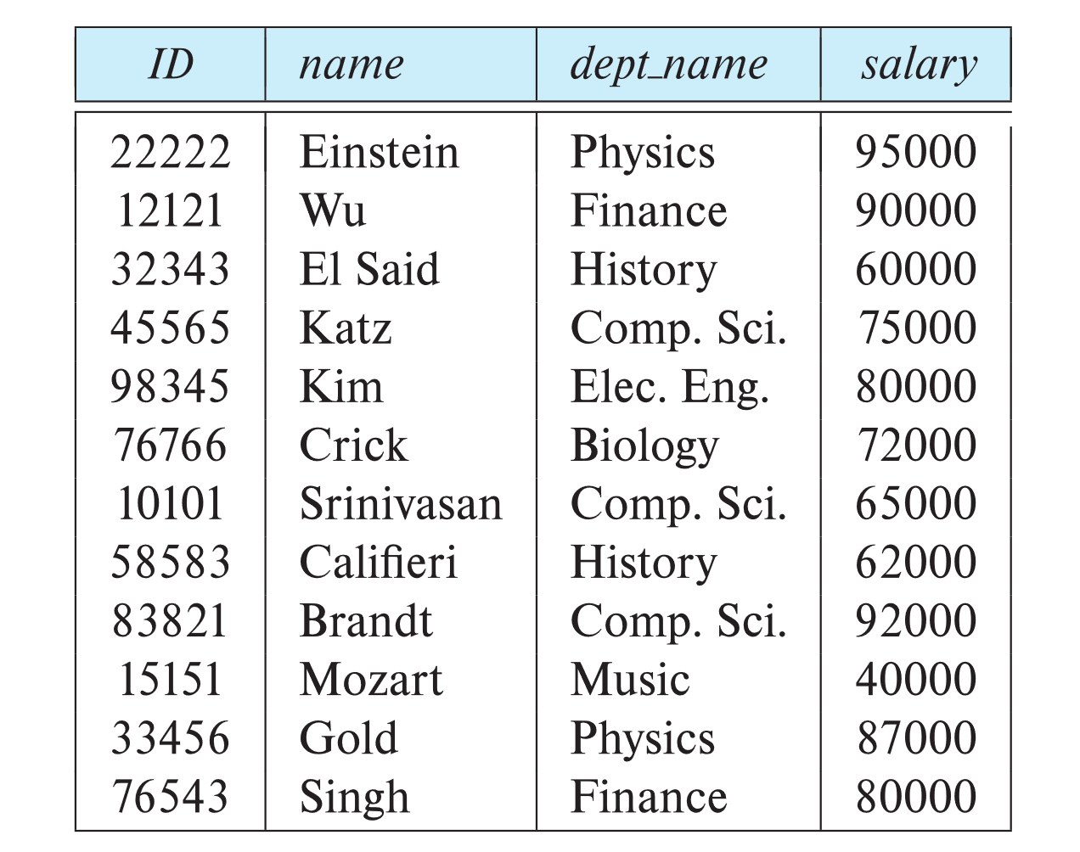
Relations Are Unordered
Order of tuples is irrelevant (tuples may be stored in an arbitrary order)
Example: instructor relation with unordered tuples

Slide 26
Relations Have a Schema
Relation schema -- is the logical structure of a relation
Database schema -- is the logical structure of the database.
Database instance -- is a snapshot of the data in the database at a given instant in time.
Example:
  schema: instructor (ID, name, dept_name, salary)
  Instance:

Slide 27
Instances and Schema
Similar to types and variables in programming languages
Logical Schema – the overall logical structure of the database
  Example: The database consists of information about a set of customers and accounts in a bank and the relationship between them
    Analogous to type information of a variable in a program
Physical schema – the overall physical structure of the database
Instance – the actual content of the database at a particular point in time
  Analogous to the value of a variable

Slide 28
Integrity Constraints (Or Keys)
Let K ⊆ R
K is a superkey of R if values for K are sufficient to identify a unique tuple of each possible relation r(R)
  Example: {ID} and {ID,name} are both superkeys of instructor.
Superkey K is a candidate key if K is minimal
  Every candidate key is a super key
  What do we mean by minimal?
    The columns included within the candidate key are sufficient to uniquely identify a row
  Example: {ID} is a candidate key for Instructor
One of the candidate keys is selected to be the primary key.
  For now, the most convenient one to uniquely identify a row

Slide 29
Integrity Constraints (Or Keys)
Primary key
  Each table must have a primary key defined
  This is enforced by SQL
Foreign key
  Tables are not required to have one
  Used when a column in one table references the primary key of a another table
    Referencing relation
    Referenced relation
  Example: dept_name in instructor is a foreign key from instructor referencing department

Slide 30
Identifying the Primary Key
Identify the Super Keys
  There are 2^{(n)}-1 unique super keys for every relation, where n is the number of columns in the relation
Identify the Candidate Keys
  Start with the list of super keys, and remove the ones that don’t make sense.
  There should be more than one
Primary Key
  Select the candidate key that most efficiently uniquely identifies a row
  There should only be one

Slide 31
Identifying the Primary Key
Identify the 15 Super Keys
  Id
  name
  dept_name
  salary
  Id, name
  Id, dept_name
  id, salary
  name, dept_name
  name, salary
  dept_name, salary
  id, name, dept_name
  id, name, salary
  id, dept_name, salary
  name, dept_name, salary
  id, name, dept_name, salary

Slide 32
Identifying the Primary Key
Identify the Candidate Keys
  Id
  name, dept_name, salary
  name, dept_name
  name, salary
Primary Key
  Id

Slide 33
Entity Relational (ER) Diagram
Ok, so a database is organized into a collection of relations.
And those relations are all interconnected.
And those relations all have a way to uniquely identify a particular row within a relation.
So, how do we effectively communicate this?
Programming is not about typing, it's about thinking. - Rich Hickey
CSC 6302 - Week 1

Slide 34
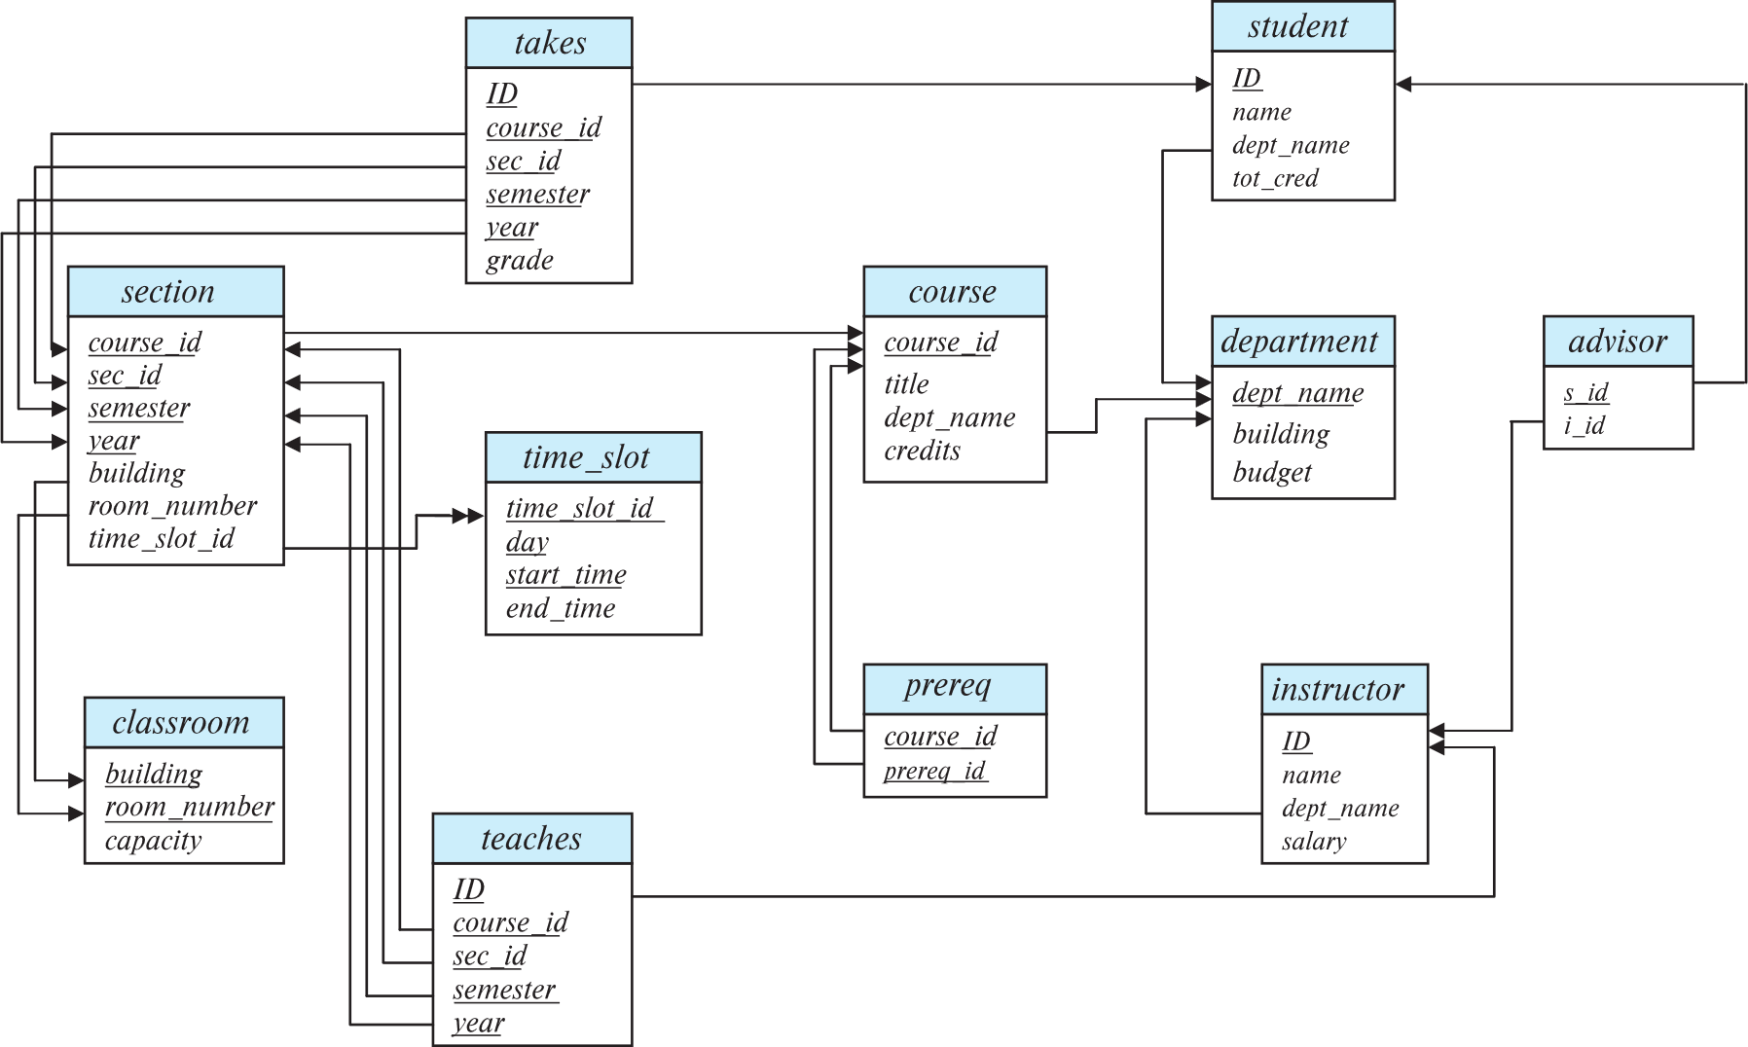
Schema Diagram for University Database

Slide 35
ER Diagram
Key Aspects
  Entities
    Real-world objects, people, or concepts
      Our tables
      Note that table design is very similar to object design
        Each table should represent one thing, and all the data needed to represent that one thing
    Represented by rectangles
    Attributes
      The columns in our tables
      Represented by text within the entity
        In some diagraming tools, they are placed within an oval
    Primary Keys:
      Unique identifiers that distinguish each instance of an entity
      Represented by underlined text.

Slide 36
ER Diagram
Key Aspects
  Relationships:
    How entities connect or act with each other
    Represented by diamonds or connecting lines
      When showing a foreign key relationship
        Ensure the referencing relation includes an arrow head pointing to the referenced relation
  Cardinality
    The numerical rules or limits of a relationship
      one-to-one
      one-to-many
      many-to-many

Slide 37
ER Diagram in MySQL Workbench
ER Diagrams are auto generated in MySQL Workbench
  Reverse Engineer Tool
    Ensure that you configure your MySQL Workbench relationships to “Connect to Columns”
      This clearly shows foreign key relationships
        Referencing table vs referenced table
All databases presented to you in class will have an ER diagram
  All databases you present to me will have an ER diagram
Reference
Generating ER Diagrams in MySQL Workbench

Slide 38
Database Architecture
Now that we understand what a database system is, and how to describe how the data within a particular database is related, let’s back up.
How do actually go about interacting with an existing database?
CSC 6302 - Week 1

Slide 39
Levels of Abstraction
Physical level
  Describes how a record is stored on disk.
Logical level:
  Describes data stored in database, and the relationships among the data.
  The Database Schema resides at this level.
View level:
  Application programs hide details of data types.
  Views can also hide information
    Sensitive information
      such as an employee’s salary
    Unneeded information
      Audience specific
        The user of the application/website
        Another programmer, working elsewhere in the product, who just views things as a black box

Slide 40
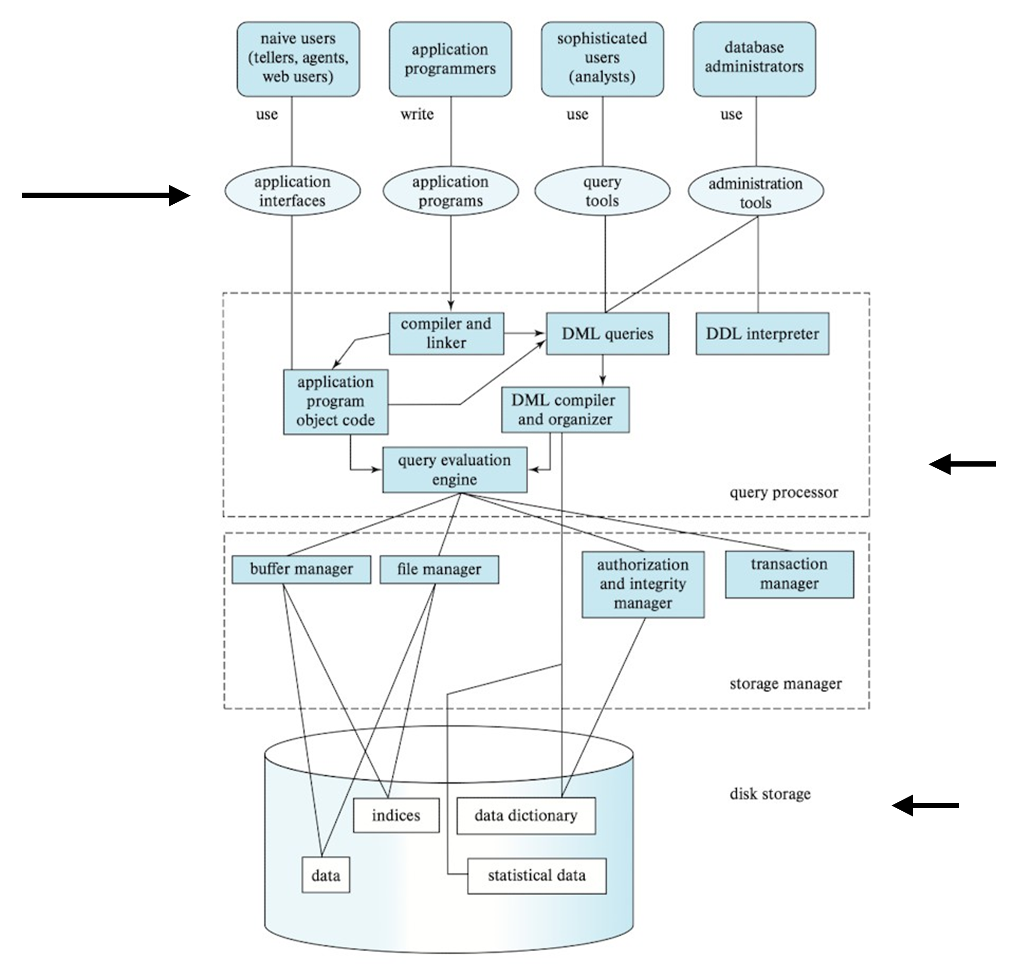
Application
Layers
View
Logical
Physical

Slide 41
Encapsulation and Abstraction
Encapsulation
  Each layer has their job to do
    And everything they need to do it
Abstraction
  Each layer reveals only what it needs to the other layers
  Each layer knows how to interact with the layer above/below
    Does not know, or care, what is actually done
Physical Data Independence
  The ability to modify the physical schema without changing the logical schema
  Applications depend on the logical schema
  Interfaces between the various levels and components should be well defined so that changes in some parts do not seriously influence others.

Slide 42
View Level
CSC 6302 - Week 1

Slide 43
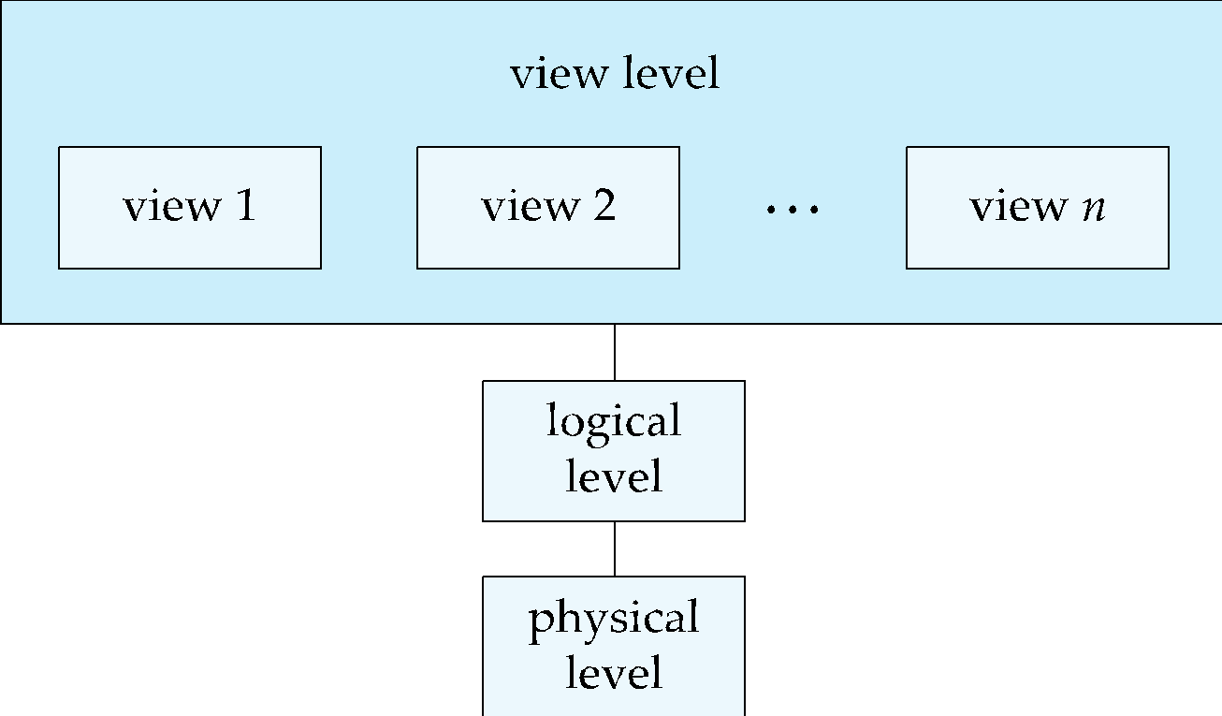
View Level
View 1 could be an application
View 2 to a web application
View 3 a Mobile application

Slide 44
View Level
Highest Level of Abstraction
  Hides the most detail about how the system works
Customizable views of the data
  Security
  Role-based permissions
  Paywalls
Who is focused on this level?
  User interface designers
  User interface programmers
    Application programmers
    Web programmers
    Mobile programmers
  Customers interact directly with this level
    This is what you “see”
    Customers may even seen multiple viewpoints

Slide 45
Logic Level
CSC 6302 - Week 1

Slide 46
What Do We Mean by Logical Level
What data is stored, and how that data relates
  Database Design
  Database
    Tables
    Attributes
    Integrity Constraints
      Primary Key
      Foreign Key
Actions taken against the data to perform tasks
  Queries
    Retrieve specific data from the database
  Stored procedures
  Functions
This class is going to be VERY focused on this level

Slide 47
Data Definition Language (DDL)
We need a way to specific what data is being stored, how it's being stored, and how it will be retrieved
  Let’s start with what/how is stored
Data Definition Language
  A specific notation for defining the database schema
    Creating databases
    Creating tables
    Defining attributes and their domains
    Defining integrity constraints
  Example: create table instructor (
  ID char(5),
  name varchar(20),
  dept_name varchar(20),
  salary numeric(8,2))
DDL Language

Slide 48
Data Definition Language (DDL)
DDL compiler
  Generates a set of table templates stored in a data dictionary
Data dictionary
  Contains metadata (i.e., data about data)
    Database schema
    Integrity constraints
      Primary key (ID uniquely identifies instructors)
    Authorization
      Who can access what

Slide 49
Data Manipulation Language (DML)
We need a way to describe how we are accessing and updating the data organized by the appropriate data model
  Data Manipulation Language
    Also known as query language
Two types of DML
  Procedural DML
    Requires user to specify what data are needed and how to get those data.
  Declarative DML
    Requires User to specify what data are needed without specifying how to get those data.
DML Language

Slide 50
Data Manipulation Language (DML)
Declarative DMLs are usually easier to learn and use than are procedural DMLs.
Declarative DMLs are also referred to as non-procedural DMLs
The portion of a DML that involves information retrieval is called a query language.

Slide 51
SQL Query Language
SQL query language is nonprocedural.
  Query input
    One or more tables
  Query output
    Single table
SQL is NOT a Turing machine equivalent language
  No network programming
  No outputting to a display
  No user interface
  Generally embedded in some higher-level language
    We will look at Python and Java later in the semester

Slide 52
Database Engine
MySql exists at the logical layer
  Runs as a service on your computer
    There are parts that interact with the view level:
      You can access MySQL via the terminal/command prompt
  Generally use another application, like MySQL Workbench, for a graphical tool
A database system is partitioned into modules that deal with each of the responsibilities of the overall system.
The functional components of a database system can be divided into
  The storage manager,
  The query processor component,
  The transaction management component.

Slide 53
Storage Manager
Interface between the Logical Level and the Physical Level
The storage manager is responsible to the following tasks:
  Interaction with the OS file manager
    OS file manager differs from OS to OS
  Efficient storing, retrieving and updating of data
    Data is physically stored on disk on your computer
    Works with the OS
The storage manager components include:
  Authorization and integrity manager
  Transaction manager
  File manager
  Buffer manager

Slide 54
Storage Manager Continued
The storage manager implements several data structures as part of the physical system implementation:
  Data files
    Store the database itself
  Data dictionary
    Stores metadata about the structure of the database, in particular the schema of the database.
  Indices
    Can provide fast access to data items. A database index provides pointers to those data items that hold a particular value.
We will get into more detail here later in the class

Slide 55
Query Processor
The query processor components include:
  DDL interpreter
    Interprets DDL statements
    Records the definitions in the data dictionary.
  DML compiler
    Translates DML statements in a query language into an evaluation plan consisting of low-level instructions that the query evaluation engine understands.
    Performs query optimization
      Picks the lowest cost evaluation plan from among the various alternatives.
  Query evaluation engine
    Executes low-level instructions generated by the DML compiler.

Slide 56
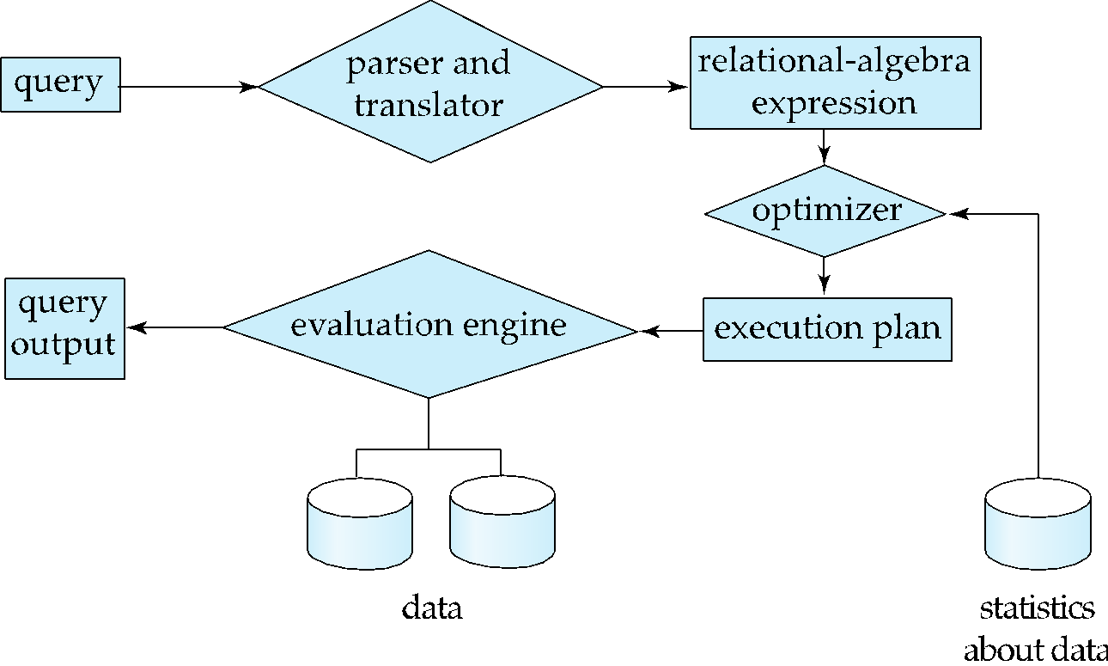
Query Processing
1. Parsing and translation
2. Optimization
3. Evaluation

Slide 57
Transaction Manager
What is a transaction?
  A distinct unit of work
    Database is in a consistent state before the work starts
    Database is in a consistent state when the work ends
Transaction management
  Imagine you and your spouse share a bank account
    You each check your balance and then spend money you know you have
      But…what if when one of you spends the money, the other no longer can afford their purchase
      The order of reads and writes matters!

Slide 58
Transaction Manager
You check your balance, and have $500 dollars in your account
  You make a $350 purchase
Your spouse checks the balance, and there is $150 in the account
  They do not make their $200 purchase
You check your balance, and have $500 dollars in your account
Your spouse checks the balance, and there is $500 in the account
  You make a $350 purchase
  They make a $200 purchase
You get hit with an overdraft fee

Slide 59
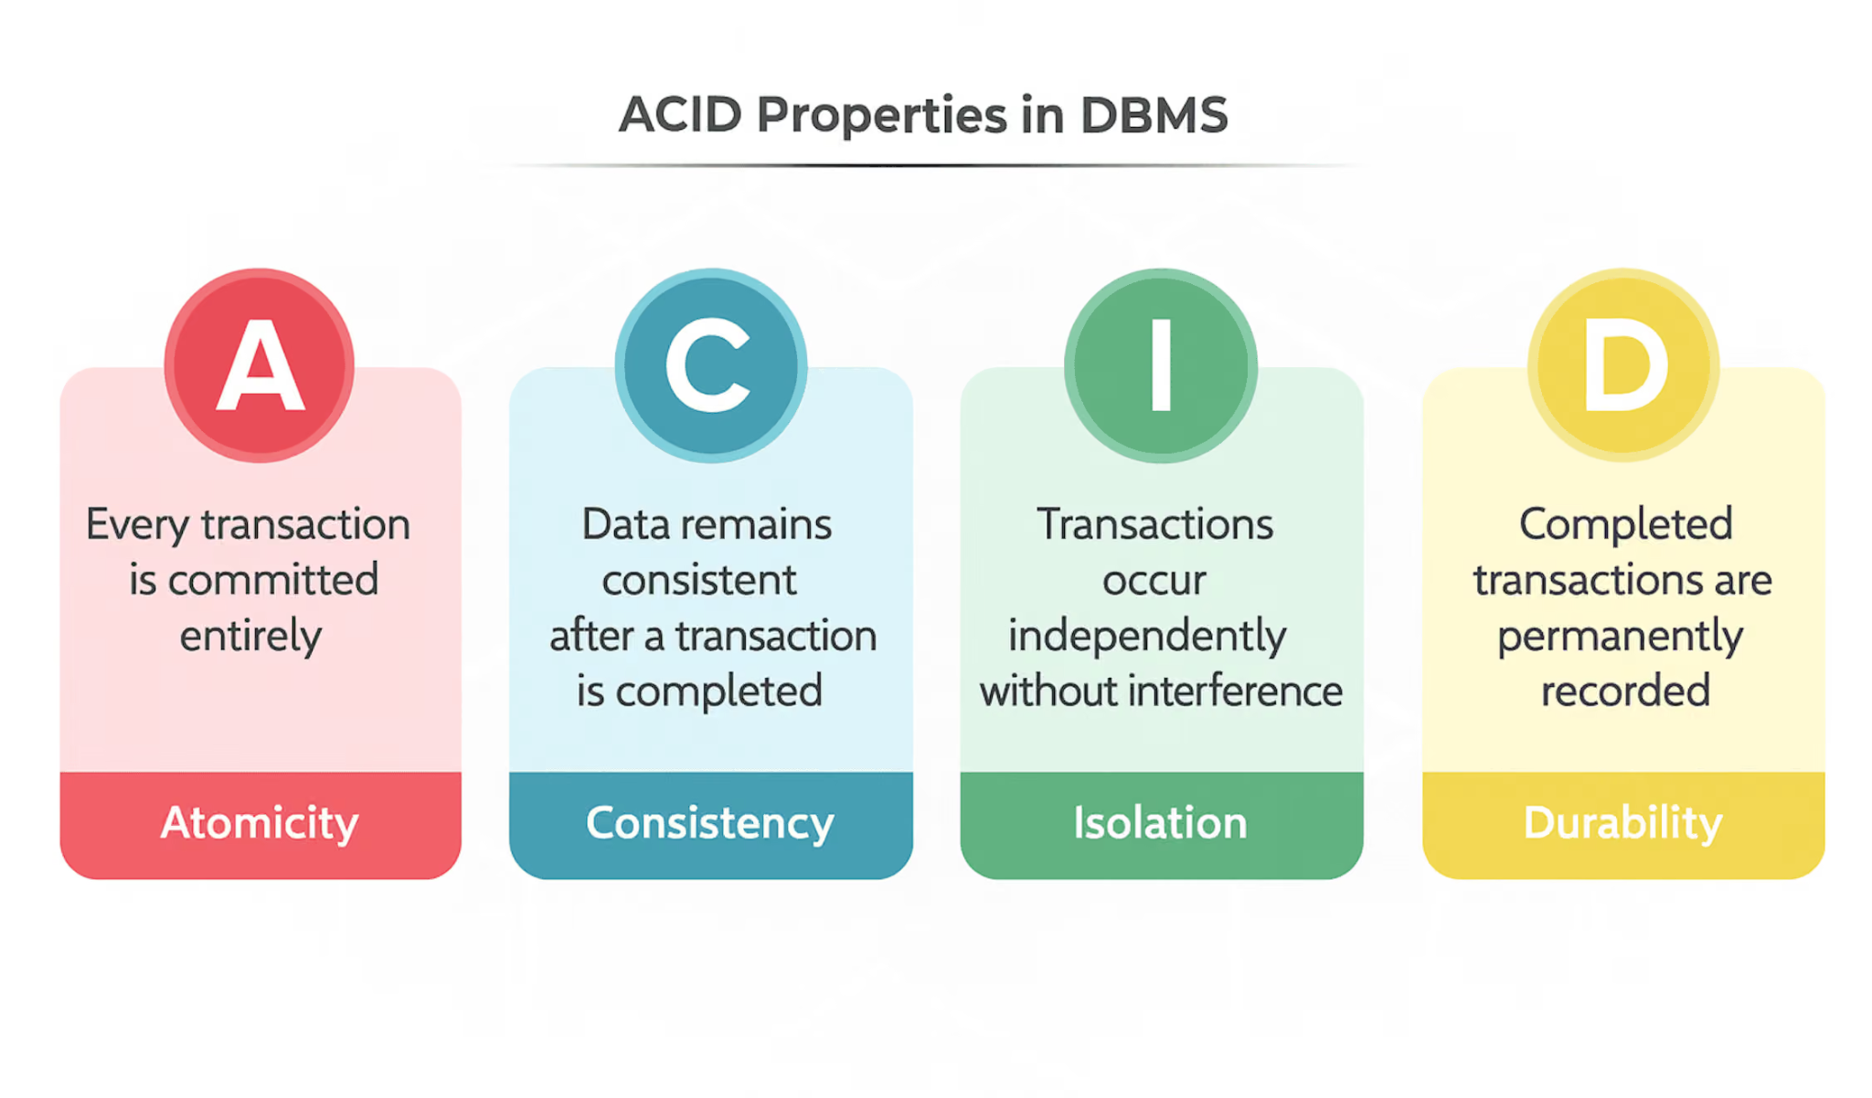
ACID
Source: ACID

Slide 60
Physical Level
CSC 6302 - Week 1

Slide 61
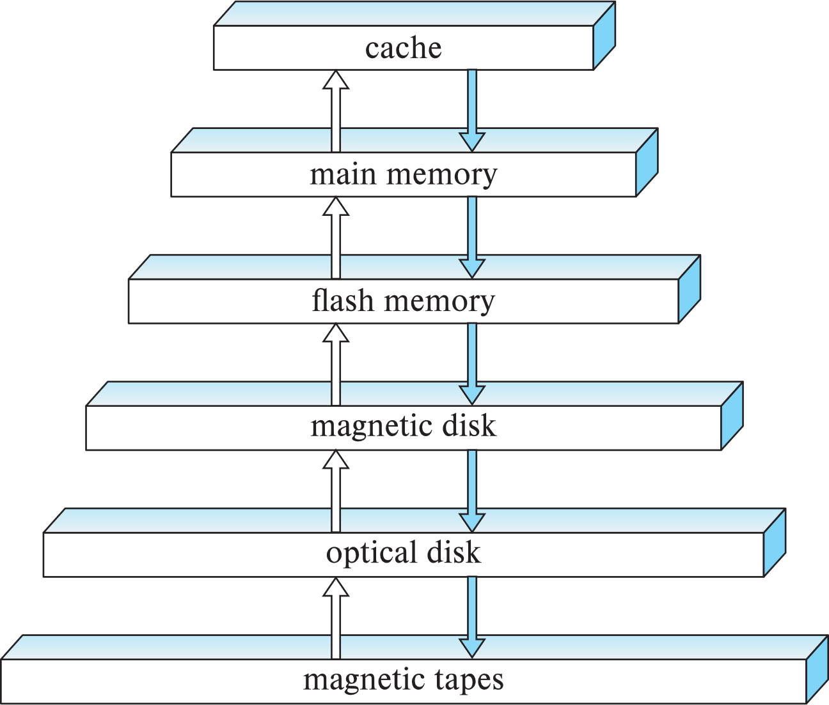
Physical Level
Deals with how data is actually stored
    On your machine
    In the cloud
    On a server
    On another machine
Just like the View level, you should be able to swap out your storage system without impacting the logical layer or the view layer
  Physical machine?
  Virtual machine?
  RAID array?
  Remote machine?
  Cloud storage?

Slide 62
Physical Level
The storage manager within a DBMS leverages how the data is stored to optimize queries and increase performance
  Primary storage, like RAM is faster to access then secondary storage, like you harddrive
    Or another machine’s hard drive
    Or cloud storage
We will dig deeper into this later in the course

Slide 63
Basic SQL
“"Where is the information? Lost in data. Where is the data? Lost in the #@%! &database!"— Joe Celko, The Guru's Guide to SQL Server Stored Procedures”
CSC 6302 - Week 1

Slide 64
Creating a Database in SQL
Goals
  DESIGN THE DATABASE
  Create the database
    Use the built in tools in MySQL Workbench
    Create a set of SQL statements, called a SQL script
  Create the tables within the database
    Again, we can use MySQL Workbench or a SQL script
  Insert data into the tables
  Query the database for particular data

Slide 65
Domain Types in SQL
char(n). Fixed length character string, with user-specified length n.
varchar(n). Variable length character strings, with user-specified maximum length n.
int. Integer (a finite subset of the integers that is machine-dependent).
smallint. Small integer (a machine-dependent subset of the integer domain type).
numeric(p,d). Fixed point number, with user-specified precision of p digits, with d digits to the right of decimal point. (ex., numeric(3,1), allows 44.5 to be stores exactly, but not 444.5 or 0.32)
real, double precision. Floating point and double-precision floating point numbers, with machine-dependent precision.
float(n). Floating point number, with user-specified precision of at least n digits.

Slide 66
Schema Definition
A schema definition provides a shorthand way of describing a table’s schema. The format of a schema definition is given below, with the underline used to identify the primary key:
TableName(column1 column1Type, column2 column2Type)
For the Department table:
Department(dept_Name varchar(20), building varchar(15), budget numeric)

Slide 67
Create Table
An SQL relation is defined using the create table command:
create table r
(A₁ D₁, A₂ D₂, ..., A_{n} D_{n},
(integrity-constraint₁),
...,
(integrity-constraint_{k}))
  r is the name of the relation
  each A_{i} is an attribute name in the schema of relation r
  D_{i} is the data type of values in the domain of attribute A_{i}
Example:
create table instructor (
ID char(5),
name varchar(20),
dept_name varchar(20),
salary numeric(8,2))

Slide 68
Create Table Note
Important Notes When Creating Tables
  Check if the table exists
  Each column needs an appropriate data type
  A primary key uniquely identifies a row
    Each table needs one
  Constraints can be used to ensure the data being insert into the table is reasonable
CREATE TABLE IF NOT EXISTS Department(
dept_name varchar(20),
building varchar(15),
budget numeric(12,2) check (budget > 0),
primary key (dept_name)
);

Slide 69
Integrity Constraints in Create Table
Types of integrity constraints
  primary key (A₁, ..., A_{n} )
  foreign key (A_{m}, ..., A_{n} ) references r
  not null
SQL prevents any update to the database that violates an integrity constraint.
Example:
create table instructor (
ID char(5),
name varchar(20) not null,
dept_name varchar(20),
salary numeric(8,2),
primary key (ID),
foreign key (dept_name) references department);

Slide 70
Schema Diagram for University Database

Slide 71
Updates to a Table
Insert
  insert into instructor values ('10211', 'Smith', 'Biology', 66000);
Delete
  Remove all tuples from the student relation
    delete from student
Drop Table
  drop table r
Alter
  alter table r add A D
    where A is the name of the attribute to be added to relation r and D is the domain of A.
    All exiting tuples in the relation are assigned null as the value for the new attribute.
  alter table r drop A
    where A is the name of an attribute of relation r
    Dropping of attributes not supported by many databases.

Slide 72
Important Inserting Note
Important Notes When Inserting Data
  Every non-nullable column needs to be specified
  Values must be listed in the same order as the columns
  Values need to fall within the column’s domain
  The table needs to exist
  You need to tell the database engine what database is being used
USING University;
INSERT INTO Department (dept_name, building, budget) values ("Mathematics", "Palmisano", 10000);
INSERT INTO Department (dept_name, building, budget) values ("Economics", "Sullivan", 20000);

Slide 73
Integrity Constraints
Programming is not about typing, it's about thinking. - Rich Hickey
CSC 6302 - Week 1

Slide 74
Referential Integrity
Ensures that a value that appears in one relation for a given set of attributes also appears for a certain set of attributes in another relation.
  Example: If “Biology” is a department name appearing in one of the tuples in the instructor relation, then there exists a tuple in the department relation for “Biology”.
Let A be a set of attributes. Let R and S be two relations that contain attributes A and where A is the primary key of S. A is said to be a foreign key of R if for any values of A appearing in R these values also appear in S.

Slide 75
Referential Integrity Continued
Foreign keys can be specified as part of the SQL create table statement
foreign key (dept_name) references department
By default, a foreign key references the primary-key attributes of the referenced table.
SQL allows a list of attributes of the referenced relation to be specified explicitly.
foreign key (dept_name) references department (dept_name)

Slide 76
Cascading Actions and Referential Integrity
When a referential-integrity constraint is violated, the normal procedure is to reject the action that caused the violation.
An alternative, in case of delete or update is to cascade
create table course (
(…
dept_name varchar(20),
foreign key (dept_name) references department
on delete cascade
on update cascade,
. . .)
Instead of cascade we can use :
  set null,
  set default

Slide 77
The Check Clause
The check (P) clause specifies a predicate P that must be satisfied by every tuple in a relation.
Example: ensure that semester is one of fall, winter, spring or summer
create table section
(course_id varchar (8),
sec_id varchar (8),
semester varchar (6),
year numeric (4,0),
building varchar (15),
room_number varchar (7),
time slot id varchar (4),
primary key (course_id, sec_id, semester, year),
check (semester in ('Fall', 'Winter', 'Spring', 'Summer')))

Slide 78
This Week's tasks
Practice Problem #1
Programming project #1
Quiz #1
CSC 6302 - Week 1

Slide 79
Practice Exercise 01
Install MySQL
Install MySQL Workbench
Optional
  Install VS Code
  Installing the Python extension for VS Code
Design a Database
The details and rubric will be provided in the practice assignment on Canvas
This counts towards the Practice Exercise grade.

Slide 80
Programming Assignment 01
In this assignment, you will be writing SQL statements to do the following:
Create the database from the practice
Create the tables from the practice
Create an ER Diagram in MySQL Workbench
Insert tuples into your tables
Add a column to an existing table
Remove a column from an existing table
This assignment counts towards the Coding Projects grade.

Slide 81
Quiz 01
This week's quiz will focus on:
Databases and Database Applications
The Relational Model
Entity Relational Diagrams (ER Diagrams)
  Database Table Design
Database Systems
  Database Architecture
  Database Engine
SQL - The Basics
  Create Table
  Insert
  Update
  Integrity Constraints
Like all quizzes, the quiz will be taken in Canvas, and is open book/note.
This counts towards the Quiz grade.

Slide 82

Check out recommended texts and videos!
Assignment | Due Date
Practice | Saturday, 11:59 PM
Quiz | Monday, 11:59 PM
Programming Assignment | Monday, 11:59 PM
Next Week - Basic SQL

